Slide 1
Direct Fourier Reconstruction
Medical imaging
Group 1
Members:
Chan Chi Shing Antony
Chang Yiu Chuen, Lewis Cheung Wai Tak Steven
Celine Duong
Chan Samson

Slide 2
Abstract
Shepp-Logan Head Phantom Model
Radon Transform
1D Fourier transformed projection slices of different angles
Convert from polar to Cartesian coordinate
Inverse 2D Fourier transform.
Reconstructed image

Slide 3
Not that simple!!!
Problem 1: Continuous Fourier Transform is impractical
Solution: Discrete Fourier Transform
Problem 2: DFT is slow
Solution: Fast Fourier Transform
Problem 3: FFT runs faster when number of samples is a power of two
Solution: Zeropad
Problem 4: F_{1D} Radon Function (polar) → Cartesian coordinate
but the data now does not have equal spacing, which
needs for IF_{2D}
Solution: Interpolation

Slide 4
Agenda
1.Theory
1.1. Central Slice Theorem (CST)
1.1.1 Continuous Time Fourier Transform (CTFT) - > Discrete Time Fourier Transform
(DTFT) -> Discrete Fourier Transform (DFT) -> Fast Fourier Transform (FFT)
1.2. Interpolation
2. Experiments
2.1. Basic
2.1.1. Number of sensors
2.1.2. Number of projection slices
2.1.3. Scan angle (<180, >180)
2.2. Advanced
2.2.1. Noise
2.2.2. Sensor Damage
3. Conclusion
4. References

Slide 5
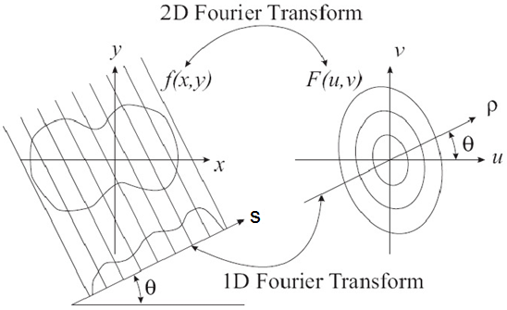
1. Theory – 1.1. Central Slice Theorem (CST)
Name of reconstruction method:
Direct Fourier Reconstruction
The Fourier Transform of a projection at an angle θ is a line in the Fourier transform of the image at the same angle. If (s, θ) are sampled sufficiently dense, then from g (s, θ) we essentially
know F(u,v) (on the
polar coordinate), and
by inverse transform
can obtain f(x,y)^{[1]}.

Slide 6
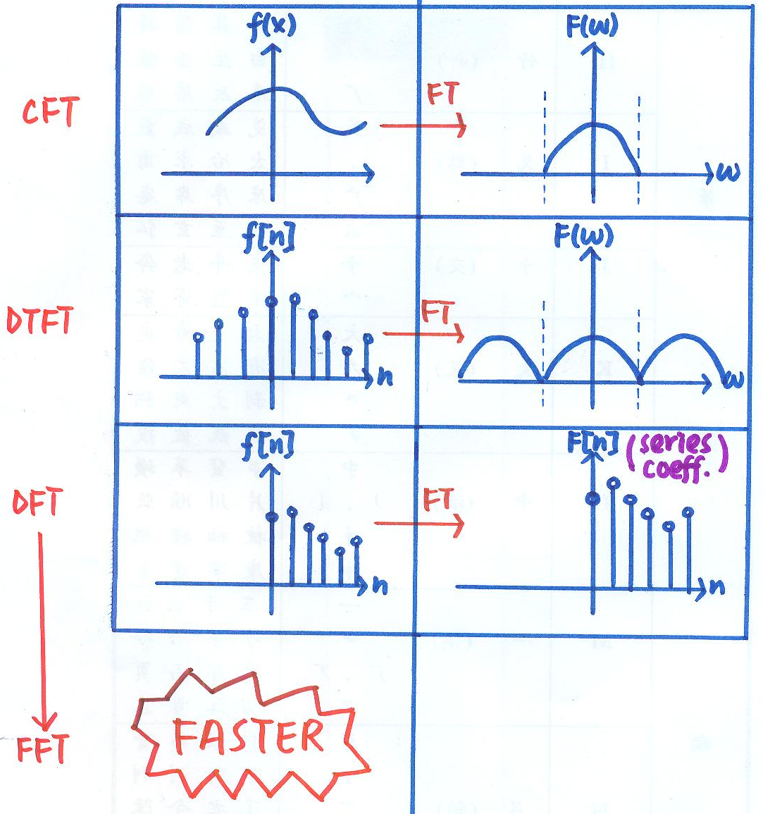
1. Theory – 1.1. Central Slice Theorem (CST) – 1.1.1 Continuous Time Fourier Transform (CTFT) - > Discrete Time Fourier Transform (DTFT) -> Discrete Fourier Transform (DFT) -> Fast Fourier Transform (FFT)
CTFT -> DTFT
Description: DTFT is a discrete time sampling
version of CTFT
Reasons: fast and save memory space
DTFT -> DFT
Description: DFT is a discrete frequency
sampling version of DTFT
Reasons: fast and save memory space
sampling all frequencies are not
possible
DFT -> FFT
Description: Faster version of FFT
Reasons: even faster

Slide 7
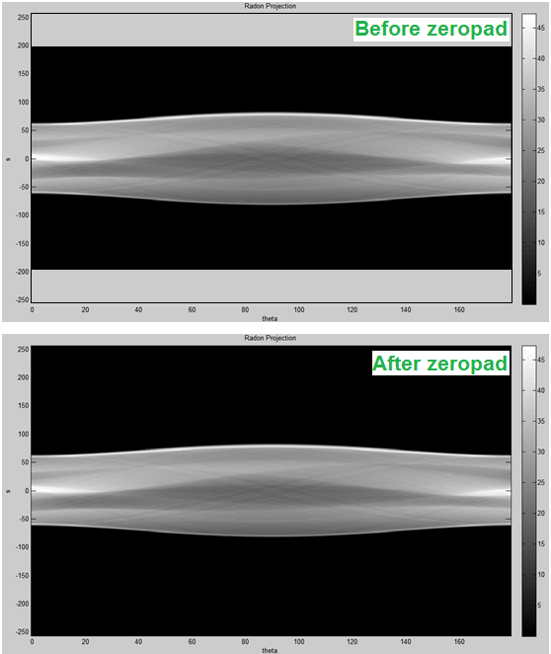
1. Theory – 1.1. Central Slice Theorem (CST) – 1.1.1 CTFT - > DTFT -> DFT -> FFT
Con’t
DFT -> FFT
Special requirement : Number of samples
should be a power
of two
Solution: Zeropad
How to make zeropad?
In the sinogram, add black
lines evenly on top and
bottom
Physical meaning?
Scan the sample in a bigger
space!

Slide 8
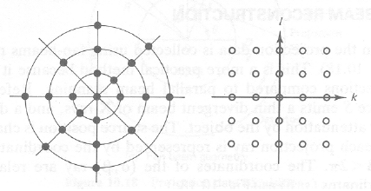
1. Theory – 1.2. Interpolation
Why we need interpolation?
Reasons : Equal spacing for x and y coordinates are required for IF_{2D}
Reasons?
1D Fourier Transform of Radon function is in polar coordinate
Convert to 2D Cartesian coordinate system, x = rcos θ and
y = rsin θ
Solution: Interpolation

Slide 9
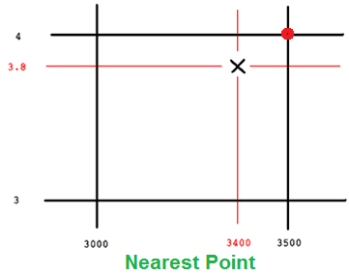
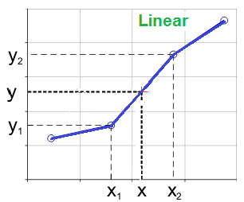
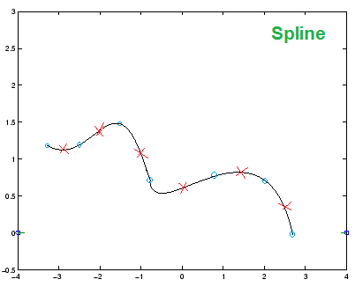
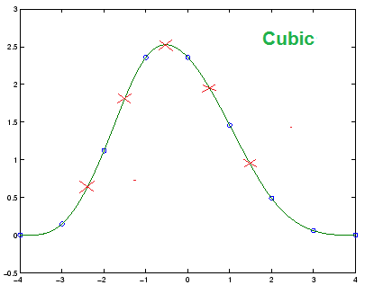
1. Theory – 1.2. Interpolation (con’t)

Slide 10

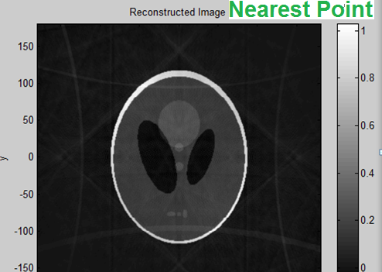
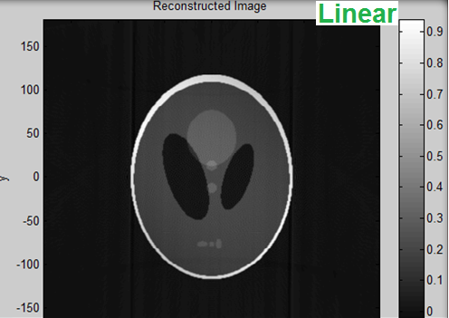
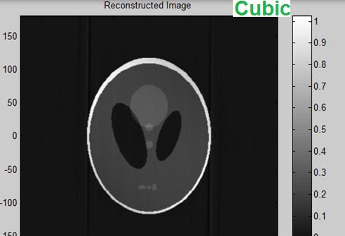
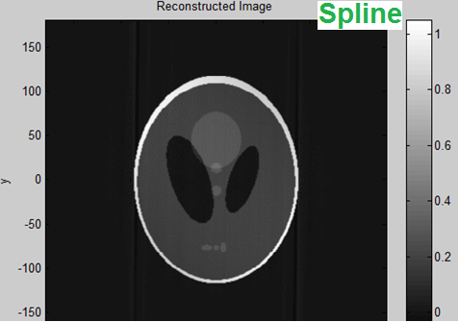
1. Theory – 1.2. Interpolation (con’t)

Slide 11
2. Experiment – 2.1. Basic – 2.1.1. Number of sensors
The number of sensors decreases
The resolution of the reconstructed images decreases and with low contrast

Slide 12

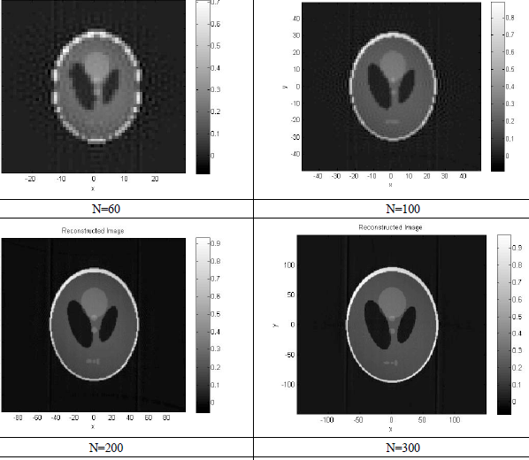
2. Experiment – 2.1. Basic – 2.1.1. Number of sensors (con’t)

Slide 13
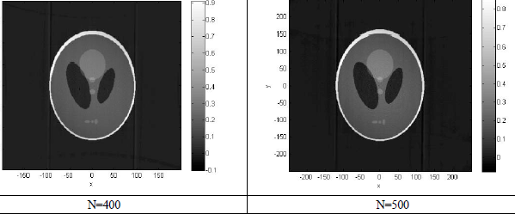
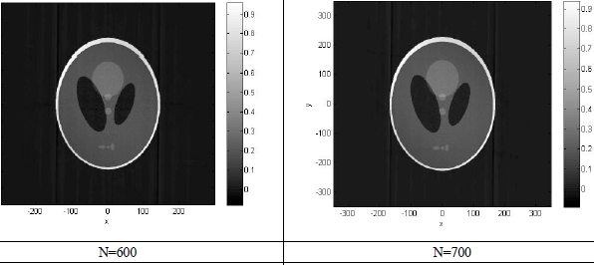
2. Experiment – 2.1. Basic – 2.1.1. Number of sensors (con’t)

Slide 14
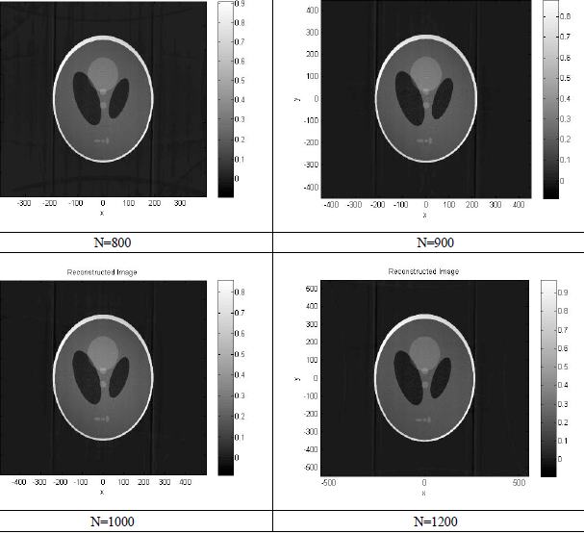
2. Experiment – 2.1. Basic – 2.1.1. Number of sensors (con’t)

Slide 15

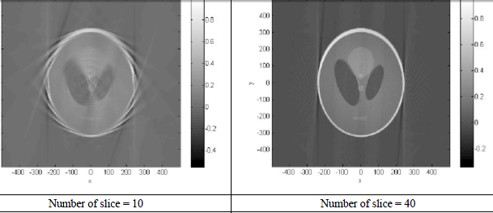
2. Experiment – 2.1. Basic – 2.1.2. Number of projection slices
As the number of projection slices decreases, the reconstructed images become blurry and have many artifacts
The resolution can be better by using more slices

Slide 16
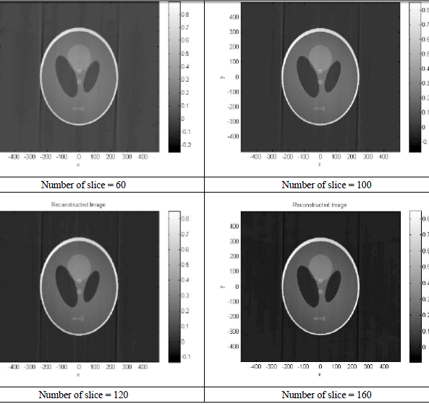
2. Experiment – 2.1. Basic – 2.1.2. Number of projection slices (con’t)

Slide 17
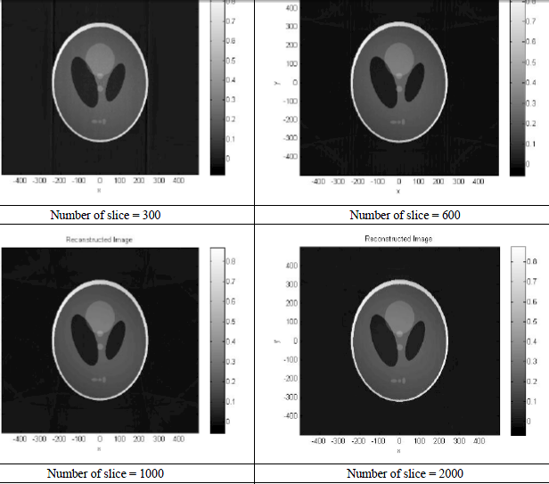
2. Experiment – 2.1. Basic – 2.1.2. Number of projection slices (con’t)

Slide 18

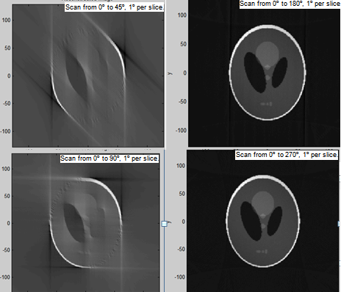
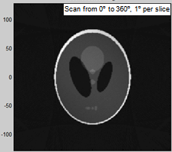
2. Experiment – 2.1. Basic – 2.1.3. Scan angle (<180, >180)
The image resolution increases as the scanning angle increases
Meanwhile artifacts
reduced

Slide 19

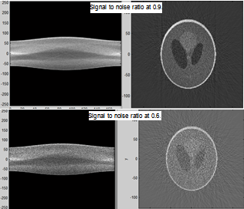
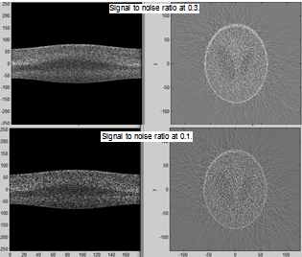
2. Experiment – 2.2. Advanced – 2.2.1. Noise
The noise is added on the sinogram
The more the noise, the more the data being distorted

Slide 20
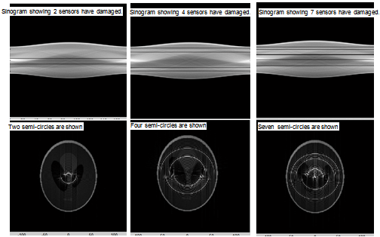
2. Experiment – 2.2. Advanced – 2.2.2. Sensor Damage
From the sinogram, each s value in the vertical axis corresponds to a sensor
If there is a sensor damaged, then it will appear as a semi-circle artifact

Slide 21
2. Experiment – 2.2. Advanced – 2.2.2. Sensor Damage (con’t)
The more the damage sensors, the lower the quality of the reconstructed images
Could we …
Replace those sensors?
Definitely yes!
2. Scan the object by 360º instead of 180º?
No.

Slide 22
3. Conclusion
Shepp-Logan Head Phantom Model
Radon Transform
1D Fourier transformed projection slices of different angles
Convert from polar to Cartesian coordinate
Inverse 2D Fourier transform.
Reconstructed image
Direct Fourier Reconstruction uses short computation time to give a good quality image, with all details in the Phantom can be conserved
The resolution is high and even there is little artifact, it is still acceptable.
To make the reconstructed images better, we can
use more sensors
use more projection slices
scan the Phantom more than 180º
add filters to eliminate noise
Replaced all damaged sensors.

Slide 23
4. Reference
1. Yao Wang, 2007, Computed Tomography, Polytechnic University
2. Forrest Sheng Bao, 2008, FT, STFT, DTFT, DFT and FFT, revisited, Forrest Sheng Bao, http://narnia.cs.ttu.edu/drupal/node/46

Slide 24
Thank you

